Slide 1

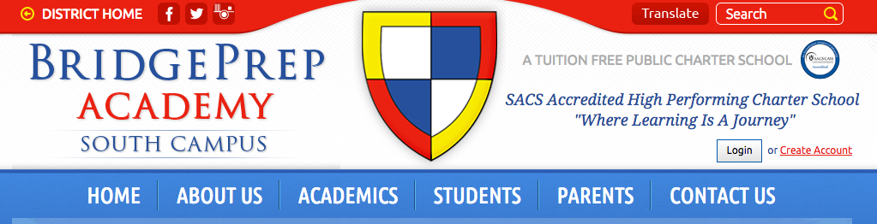
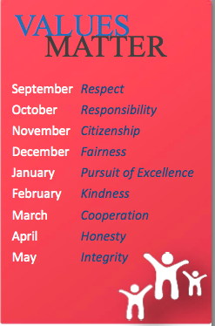


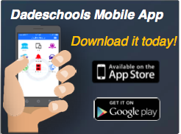
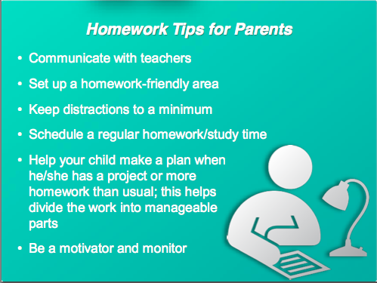






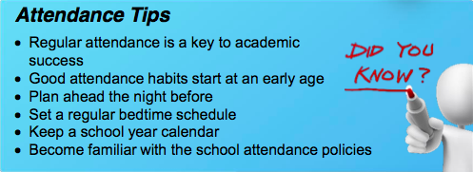

September- Brilliant
October- Understanding
November- Loyal
December- Leaders
January- Determined
February- Optimistic
March- Genuine
April- Citizenship
May- Integrity
SCHOOL WEBSITE
Parents must create an account to sign in. Once you create an account you will receive automatic notifications throughout the school year.
Items posted on our website:
Monthly Calendar
Lunch Menu
School events, activities and fundraisers
Educational Links
Teacher Websites
School Store- pay for field trips, lunch, etc.
Becoming a School Volunteer
Register on the MDCPS website as a school volunteer
Join PALS: parents as liaisons
Get your student’s individual logins to our computer programs

